Slide 1
PRINCIPLES OF INTERNET PROGRAMMING (IT205N) ASSIGNMENT 2
TEAM MEMBER:
Ng Yuan Shen, Chin See Ying,
Nicolas Chng Wei Liang, Tan Chong How

Slide 2
System Flow

Slide 3

Login

Slide 4
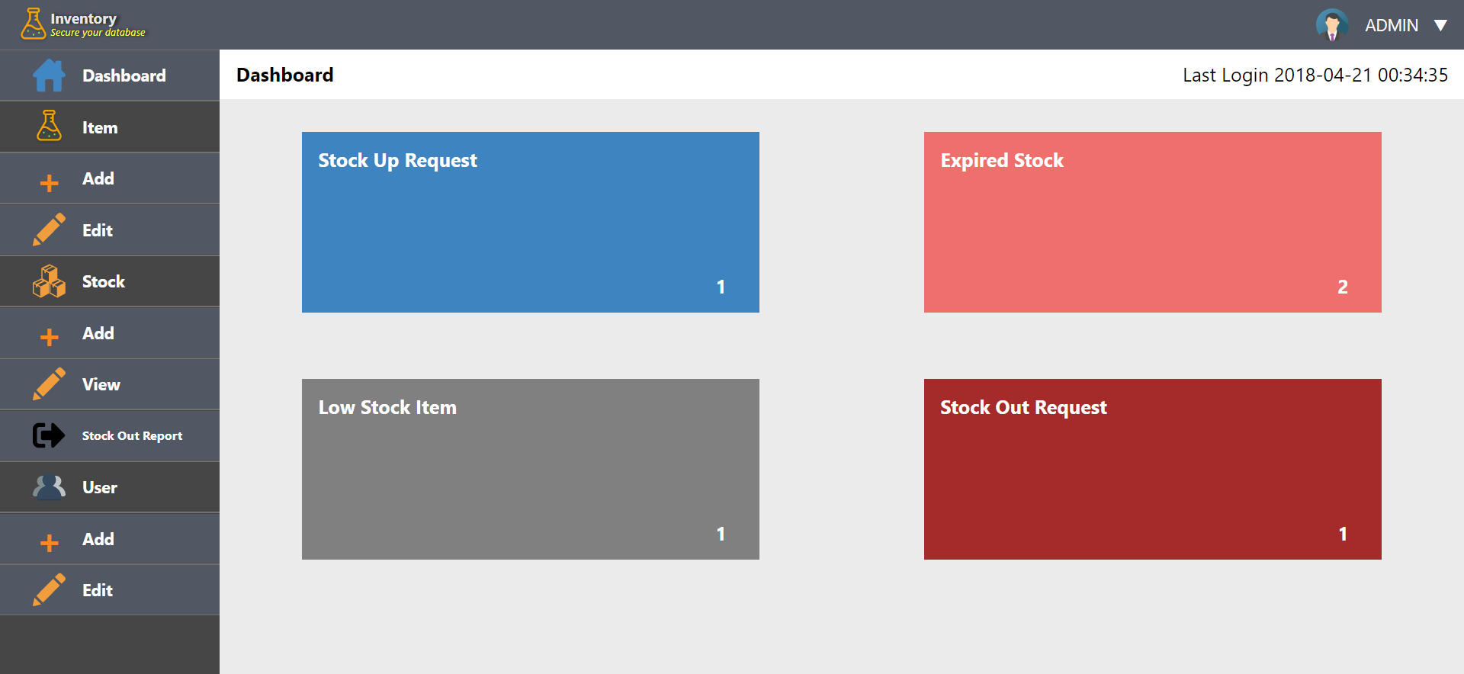
Receive Notification (Admin)

Slide 5
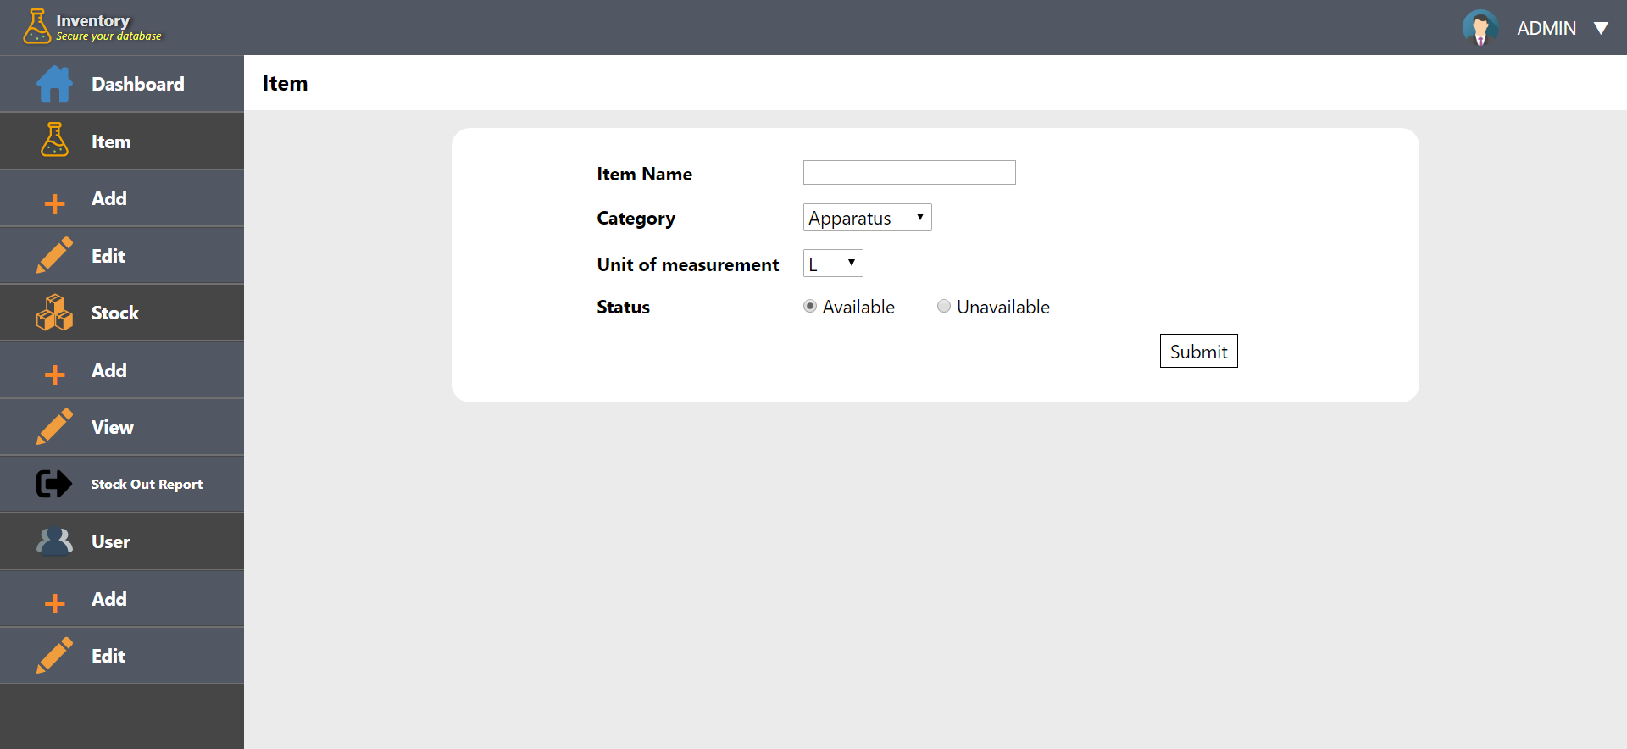
Add Item (Admin)

Slide 6
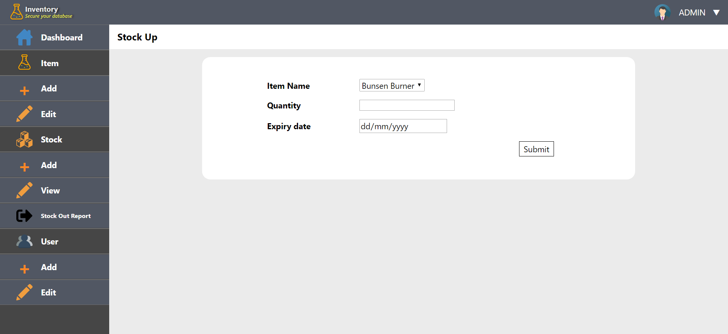
Stock Up (Admin)

Slide 7
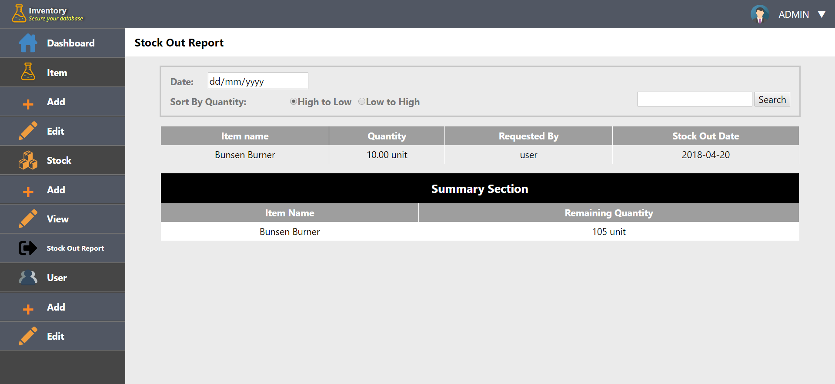
Stock Out Report (Admin)

Slide 8

Add User (Admin)

Slide 9
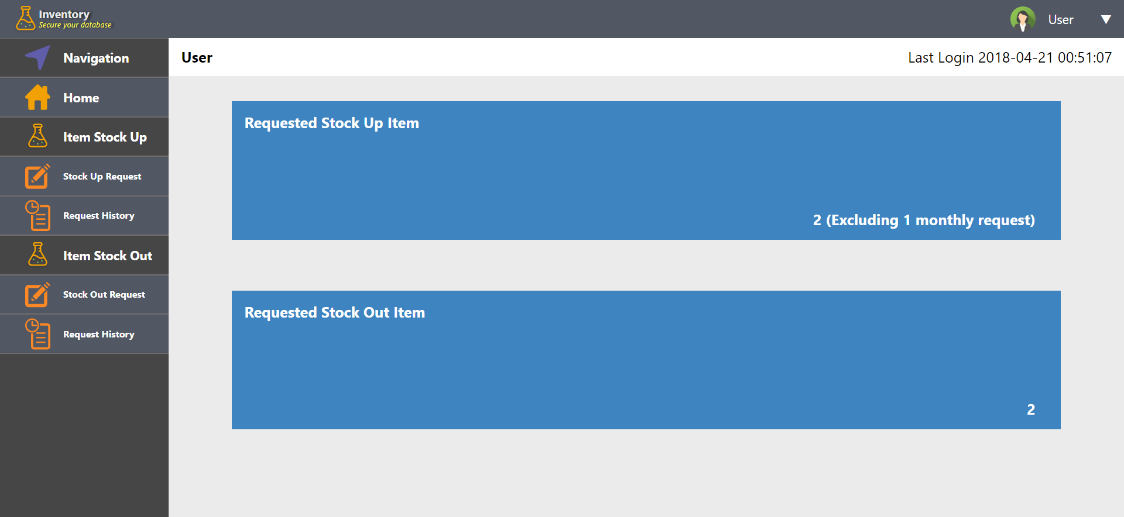
Receive Notification (User)

Slide 10
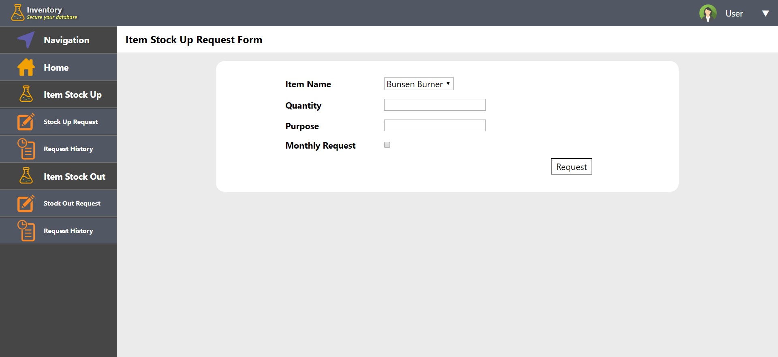
Stock Up Request (User)

Slide 11
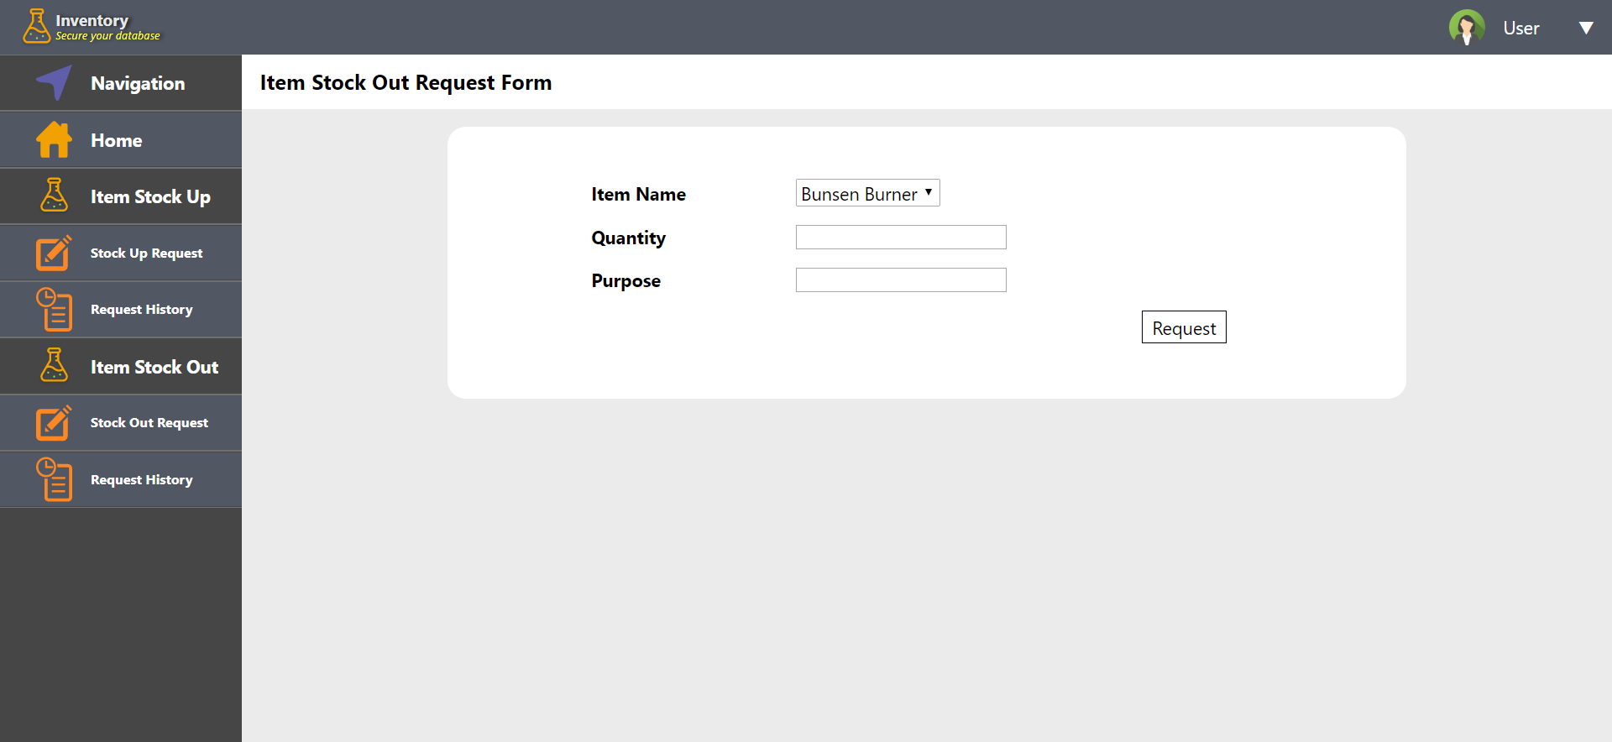
Stock Out Request (User)

Slide 12
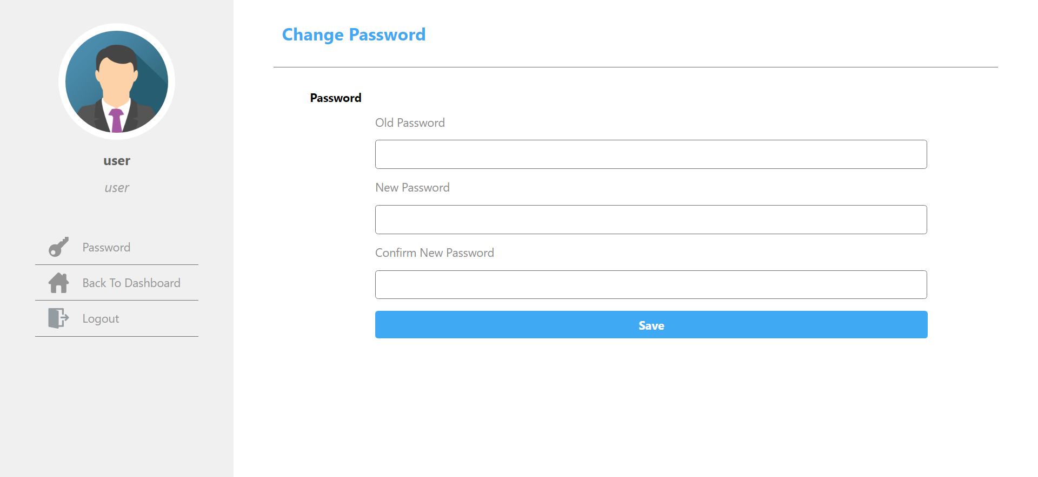
Changing Password

Slide 13
Reflection
Learnt more about PHP and MySQL database
Insight towards backend operation of stock management system
Developing user-friendly web application
Critical thinking and logical thinking
Team work and task distribution

Slide 14
Future Improvement
Content pagination (splitting large list of content into pages)
Adding of measurement unit by admin
Getting real time data (request, notification, searching) using AJAX
Improved function of monthly stock up request

Slide 15
Thank You

